Slide 1
Black Girl White Coat Academy
Introduction to Mentoring
Sandra Coker, MD | Founder
Christle Nwora, MD | Treasurer

Slide 2
Connect with Us!
Use the chat function in Google Meet
Tweet at us with #BGWCAcademy
Respond to the stories on Instagram

Slide 3
Who is in the room? Drop your school in the chat box!

Slide 4
Meet the Speakers
Sandra Coker, MD
Founder of Black Girl White Coat
University of Chicago Emergency Medicine - PGY 3
McGovern Medical School
Baylor University

Slide 5
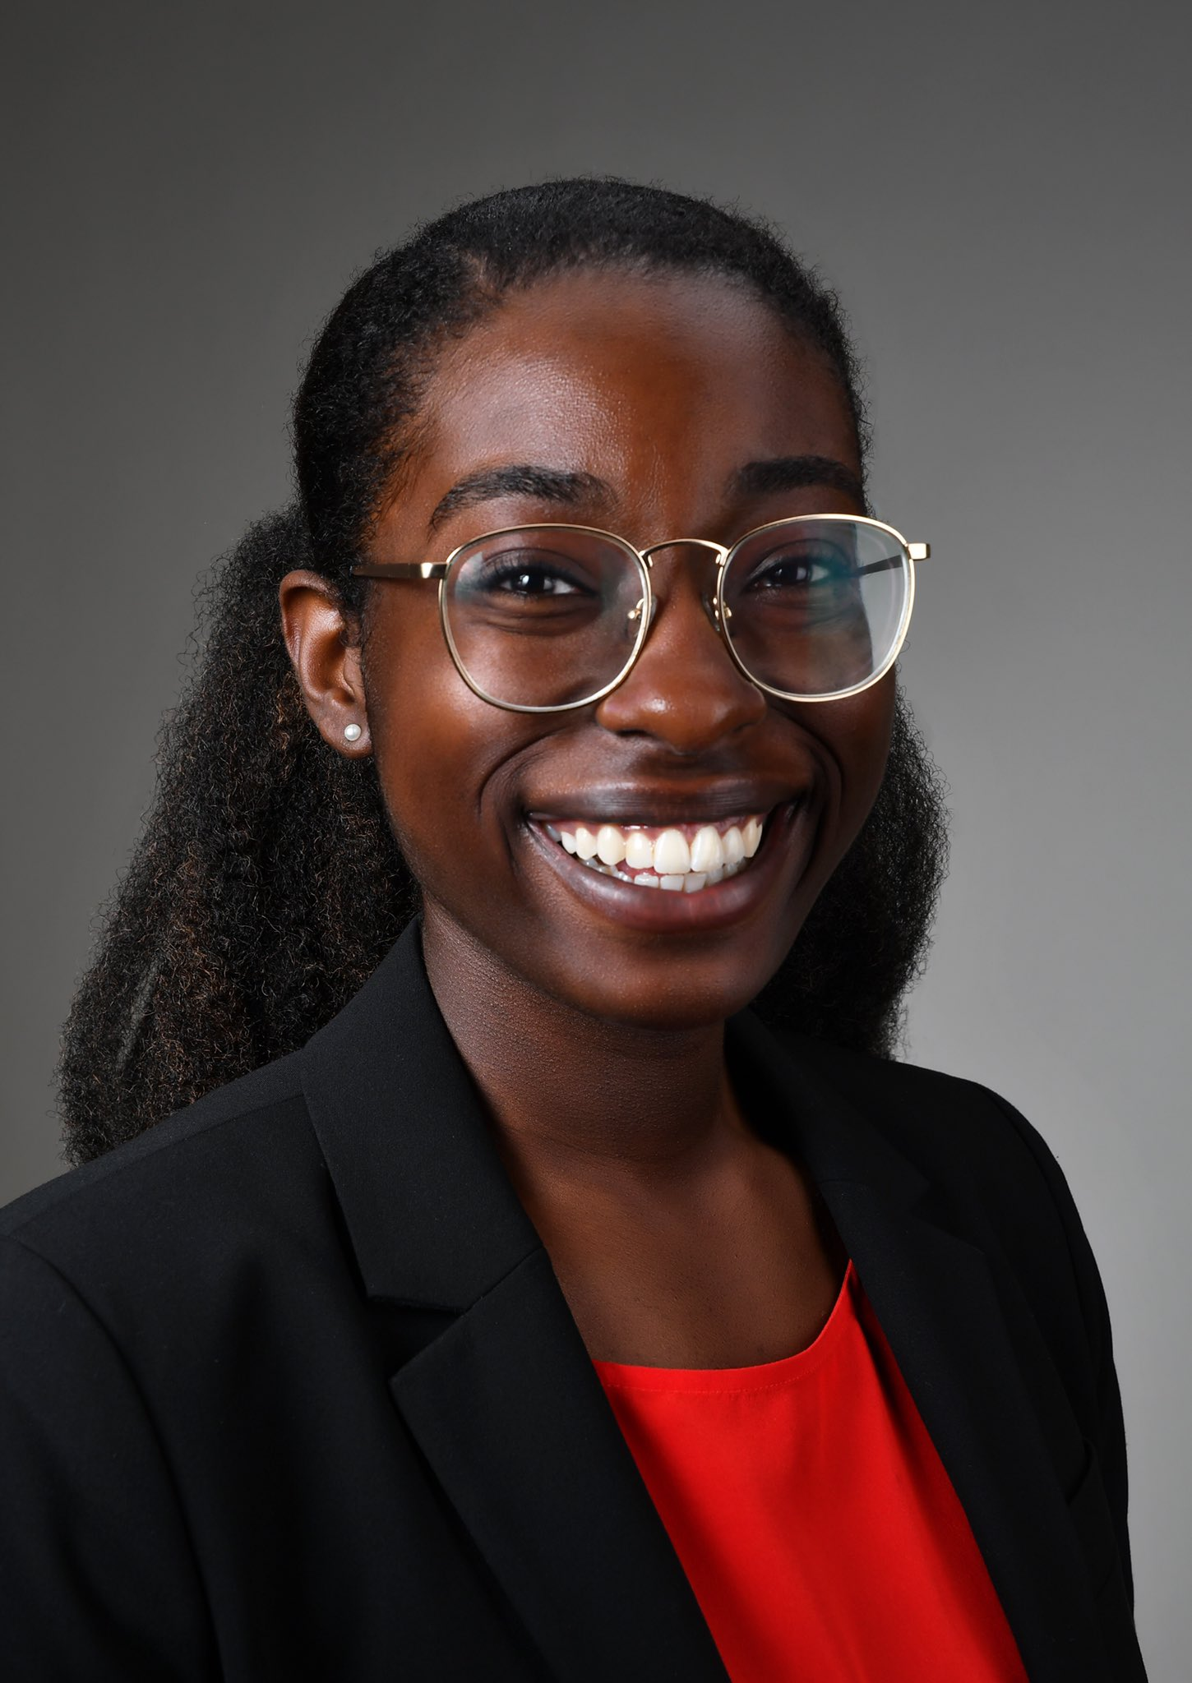
Meet the Speakers
Christle Nwora, MD
Treasurer of Black Girl White Coat
Johns Hopkins Internal Medicine - Pediatrics - PGY 3
McGovern Medical School
The University of Texas at Austin

Slide 6
BGWC Academy: Introduction to Mentoring Objectives
Define mentorship and describe the roles of a mentor and mentee
Learn how to identify and approach a potential mentor
Design a mentoring contract to maintain a healthy mentoring relationship

Slide 7
Case 1: Stephanie
Stephanie is a sophomore at the State University who is interested in becoming a physician. She is a first generation college student and does not know any doctors outside of her pediatrician from her hometown. She wants to know how to navigate the process of applying to medical school and learn more about being a physician.
What kind of support does she need?

Slide 8
What is mentorship?
a mentorship explores strategic career development in a supportive manner that facilitates mentee growth
Notes:
Note: This is different from advising. Stephanie may benefit from seeing the Pre Health Office at her undergrad who can help make sure she has a road map of what to do. But she can also benefit from a mentor who can help her think more about her future career.

Slide 9
Roles and Responsibilities
Mentee | Mentor
Identifies goals and communicates them with their mentor | Work to help mentee identify SMART goals
Coordinates the logistics of the meeting including scheduling and platform | Connects mentee to other mentors, opportunities and sponsors
Sets an agenda and provides any relevant documents for review | Reviews agenda and relevant documents ahead of time
Seeks and welcomes feedback | Provides guidance and constructive feedback
Maintain respect for one another by being timely, responsive, engaged in the mentoring relationship
ACP Mentoring Agreement, 2022

Slide 10
Types of Mentoring Relationships
One-to-one mentoring
Group mentoring
Online mentoring
Peer mentoring
One mentor is connected with one mentee
One mentor is connected with multiple mentees
The mentorship relationship is facilitated online
A mentor who is closer to you in stage of career

Slide 11
That sounds great, but how do I find a mentor?

Slide 12
Looking for a mentor?
On campus
Off Campus
Pre Health Organizations
Seniors/
Alumni
Conferences
Black Girl White Coat
Example: MAPs, AED
Example: recent graduates, professors
Example: Local medical school, AMEC, LMSA
Sign up for our next call for mentees!

Slide 13
BGWC Mentorship Program
We help get you going in the right direction!
Mentors
Mentees
Primarily Black
Welcome Allies
Increase in LGBTQ+ members
At various stages of their academic journey
Most open to in-person/hands-on meetings
Black & Hispanic students
Motivated and goal oriented
Open to students at every stage of their journey
Expectation to give back to BGWC
Notes:
Flagship Program started in Spring 2020. Continued to Fall 2020, Spring 2021, and our most recent semester Spring 2022)
Total over 660 Mentees come through our program
Spring MP Stats: 213 Matches made of 237 total mentees applied. 90% match rate
Matches made based on mentor and mentee career path, personal preferences, physical location x desire to meet in-person

Slide 14
Case 1: Stephanie
Stephanie is a sophomore at the State University who is interested in becoming a physician.
One on One Mentoring: Pediatrician from her hometown
Small Group Mentoring: Local physician who mentors a group via her Pre Health Organization
Online Mentoring: Resident who volunteers via BGWC
Near Peer Mentoring: Senior college student in her Pre Health Organization

Slide 15
Case 2: Carlos
Carlos is a junior at the State University and has set up his first meeting with a mentor he met via BGWC. His goal is to be a dentist.
How can he ensure he has a successful meeting?

Slide 16
Making the Most of Your Time!
Positive
Open
Remains eager and excited to learn
Ready to be challenged and stretched
Engaged
Motivation
Puts away his phone to minimize distractions
Takes initiatives to plan next steps
Timely
Thankful
Shows up on time for the meeting
Appreciative of the mentor’s efforts

Slide 17
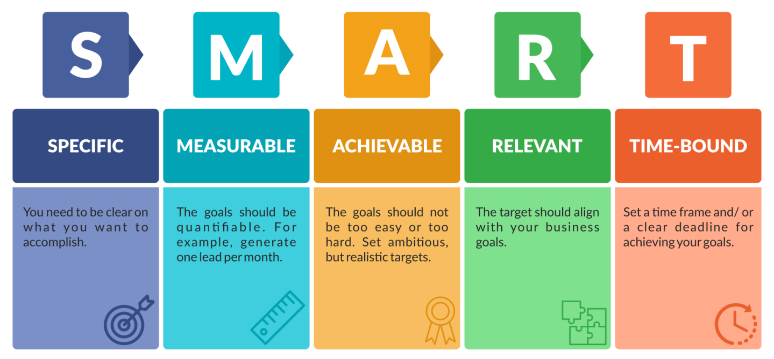
SMART GOALS
Launch Space, 2022

Slide 18
Reflect on your goals! Select one and apply the SMART framework

Slide 19
Carlos’ SMART Goals
Specific
Measureable
Actionable
Relevant
Time Bound
Research dental programs in my state
Look at 2 programs a week
Light course load so it is doable
Dentistry is what I want to do
I want to finish before midterms

Slide 20
Defining the Mentorship Relationship!
Goals
Show your SMART goals and discuss your dreams!
Expectations
Review roles of the mentee and mentor
Communication
Establish how frequently you will meet

Slide 21
Case 2: Carlos
Carlos met with his mentor over zoom. He shared his goal to research dentistry programs in his area. His mentor shared his opinions on the programs and also let Carlos know of an interest meeting at one dentistry program. They agree to meet monthly to check in and Carlos says he will communicate any updates via email.

Slide 22
Dear [Mentor’s Name],
Thank you for meeting with me to discuss my dreams of becoming a [future career]. I will focus on [list goals]. As discussed, I would like to meet every [time interval] to check in! Before our next meeting I will [action item].
Thank you,
A Happy Mentee

Slide 23
Wrap Up!
The Basics
Reaching Out
Follow Through
Defined mentorship and described the roles of a mentor and mentee
Learned how to identify and approach a potential mentor
Designed a mentoring contract to maintain a healthy mentoring relationship

Slide 24
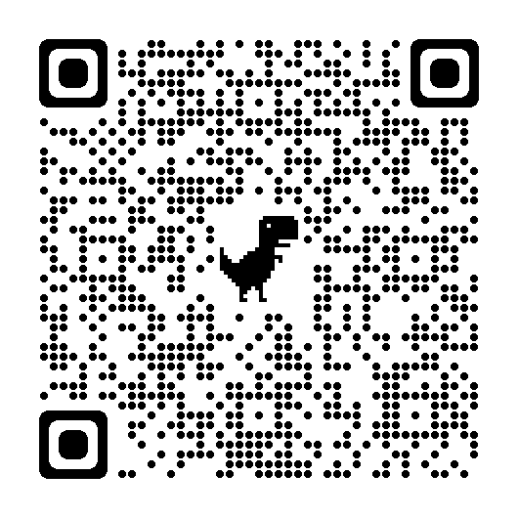
Questions?
Fill out our post webinar survey!

